Slide 1
Active transport 12. Exocytosis 23. Metaphase
Anaphase 13. Facilitated diffusion 24. Mitochondria
Cancer 14. Filtration 25. Nucleus
Cell cycle 15. Glycoprotein 26. Osmosis
Cells 16. Golgi apparatus 27. Passive
Chloroplast 17. Hypertonic transport
Cholesterol 18. Hypotonic 28. Peripheral
Differentiation 19. Integral protein protein
Diffusion 20. Interphase 29. Peroxisome
Endocytosis 21. Isotonic 30. Phospholipid
Endoplasmic 22. Lysosome 31. Prophase
reticulum 32. Ribosome
33. Telophase

Slide 2
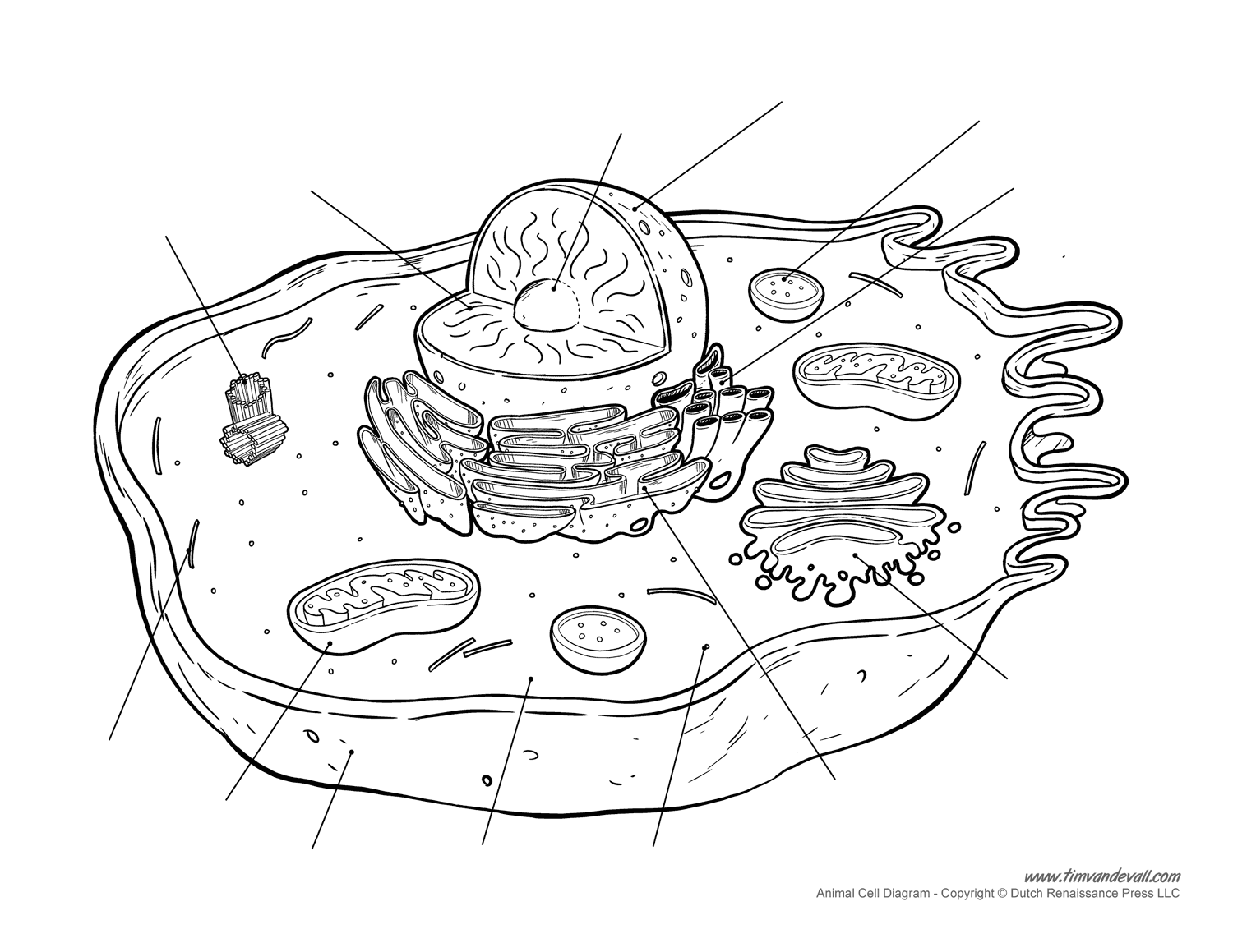

Slide 3
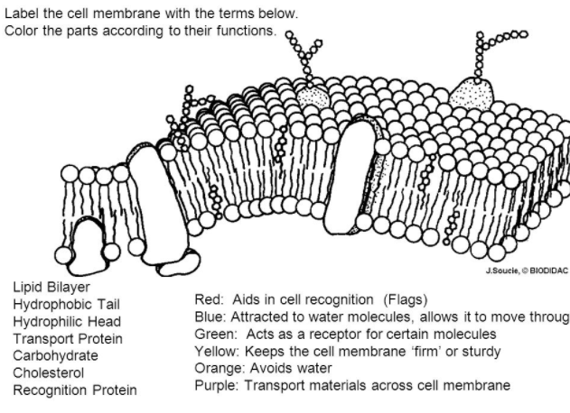

Slide 4
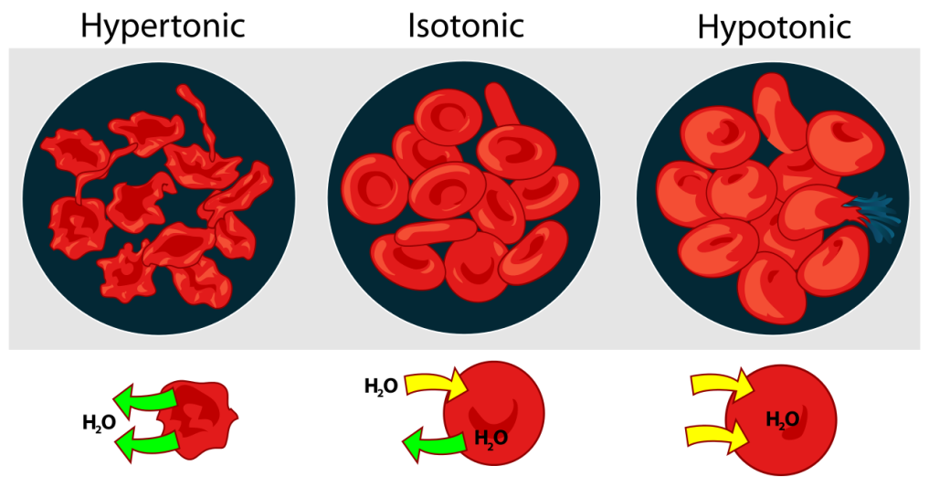

Slide 5
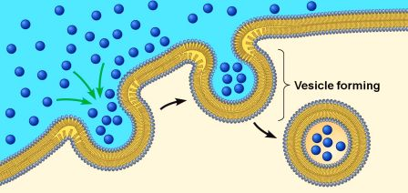
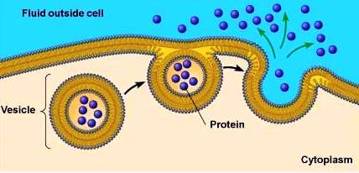

Slide 6
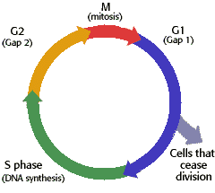

Slide 7
